Slide 1
MEDISPHERE
Smart Hospital Management System
Connecting Patients, Doctors & Administrators on one intelligent platform
PROJECT TEAM
Abhilash
Varshith
Farheen
Team Lead
Team Member
Team Member
Kalpanadevi
Santhosh
Team Member
Team Member

Slide 2
PROJECT INTRODUCTION
Why MediSphere?
Hospitals juggle patient records, doctor schedules, and administrative tasks across disconnected systems — slowing down care and increasing the risk of errors.
The Problem
Our Solution
Scattered Records
Unified Platform
Patient health history spread across paper files and isolated systems.
One system for Patient, Doctor, and Admin — data flows in real time.
Delayed Insights
Live Vital Tracking
No real-time visibility into vital signs or emerging health risks.
Continuous monitoring of patient vitals for faster decisions.
Manual Coordination
Predictive Intelligence
Admins, doctors, and patients rely on manual, error-prone communication.
Built-in ML model flags diabetic risk early, from patient data.
02

Slide 3
PROJECT GOALS
What MediSphere Aims to Achieve
01
02
03
Centralize patient, doctor & admin data
Enable real-time vital monitoring
Predict diabetic and cardio risk early
Single source of truth for hospital records and workflows.
Track live vital data so doctors can respond faster.
Use a Python-based ML model to flag at-risk patients.
04
05
06
Simplify role-based access
Reduce administrative overhead
Build a scalable foundation
Give patients, doctors, and admins the right tools for their role.
Automate scheduling, records, and reporting tasks.
Architect the system to support future modules and integrations.
03

Slide 4
TECHNICAL STACK
Built With
FRONTEND
BACKEND
DATABASE
React.js
Spring Boot/ Java
Mongo db
Responsive UI for Patient, Doctor & Admin dashboards
APIs handling authentication, records & role-based access
Structured storage for patient, doctor & admin records
ML / PREDICTION
VITALS PIPELINE
VISUALIZATION
Python (Scikit-learn)
REST APIs
Chart.js
Diabetic and cardio prediction model trained on patient health data
Ingests and streams live vital data to the dashboard
Renders health trends and prediction results as charts
04

Slide 5
SYSTEM ROLES
Three Roles, One Platform
MediSphere is designed around three distinct users, each with a tailored experience.
Patient
Doctor
Admin
Full personal health record
Access to patient health history and can view patient 360 data
Manages hospital-wide records
Live vital data tracking
Live vitals for assigned patients
Oversees doctor & patient accounts
Diabetic and cardiovascular risk prediction
Review AI prediction results and alerts
Monitors system operations and audit logs
05

Slide 6
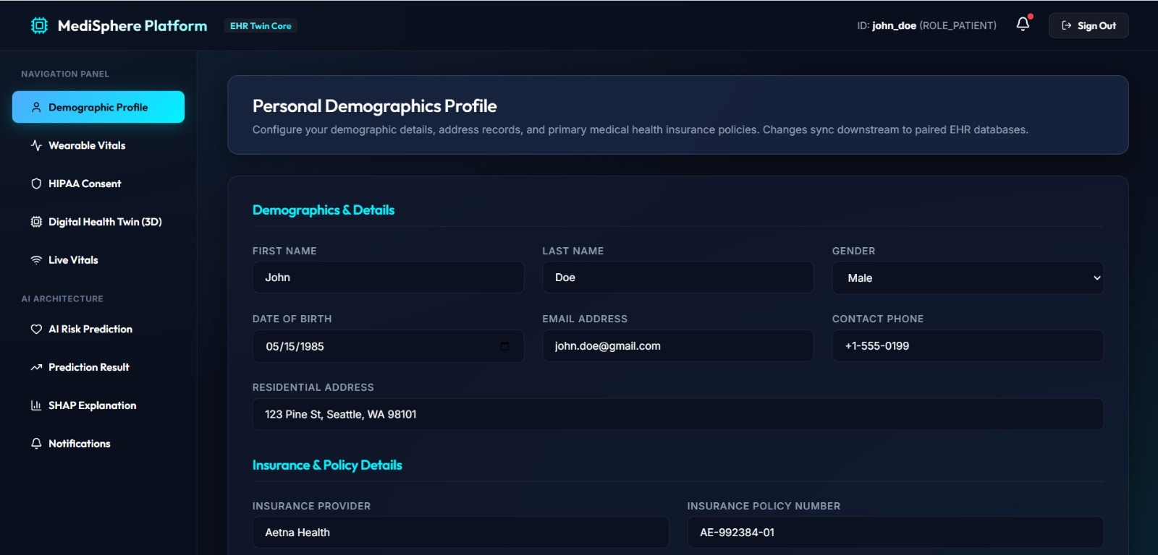
ROLE DEEP DIVE · 01
Patient Module
Patients get a complete view of their own health — full medical history, continuously updated vitals, and an ML-driven diabetic risk score.
Full health data: history, personal digital health twin
Live vital data: heart rate, BP, glucose, SpO2
AI prediction score with risk category and real time health notification
Model Snapshot
Algorithm
Logistic Regression / Random Forest
Input features
Glucose, BMI, age, BP, family history
Output
Risk category: Low / Moderate / High
06

Slide 7
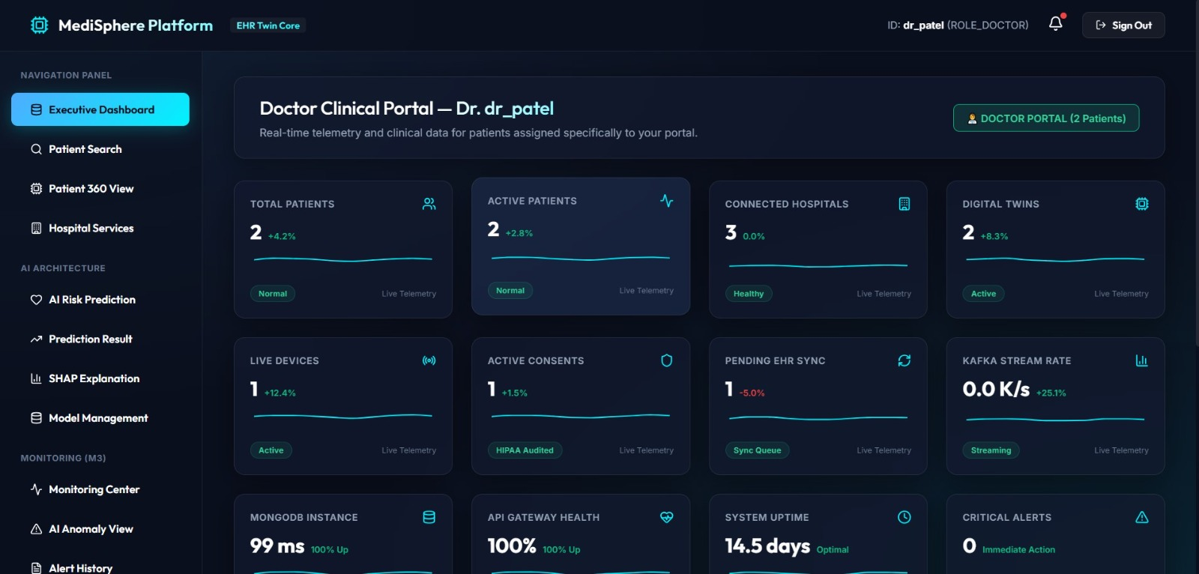
ROLE DEEP DIVE · 02
Doctor Module
Doctors get a consolidated clinical view across their assigned patients, with live vitals and prediction results to prioritize care.
Access assigned patients' full health records
Monitor live vitals across the patient panel and Real time critical alerts
Review diabetic and cardiovascular risk flags to prioritize follow-ups
Doctor View Highlights
Panel size
Assigned patients only
Alerts
Flags for abnormal vitals / high risk
Actions
Add notes, update prescriptions
07

Slide 8
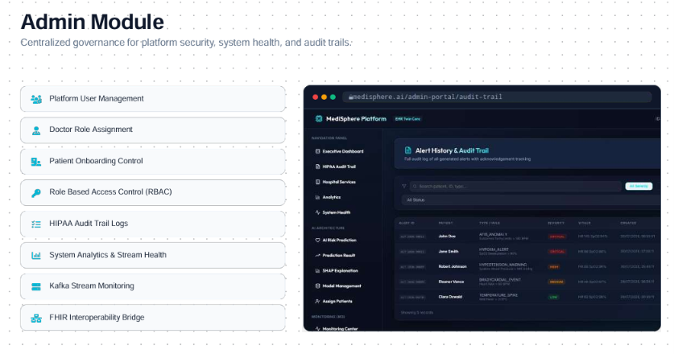
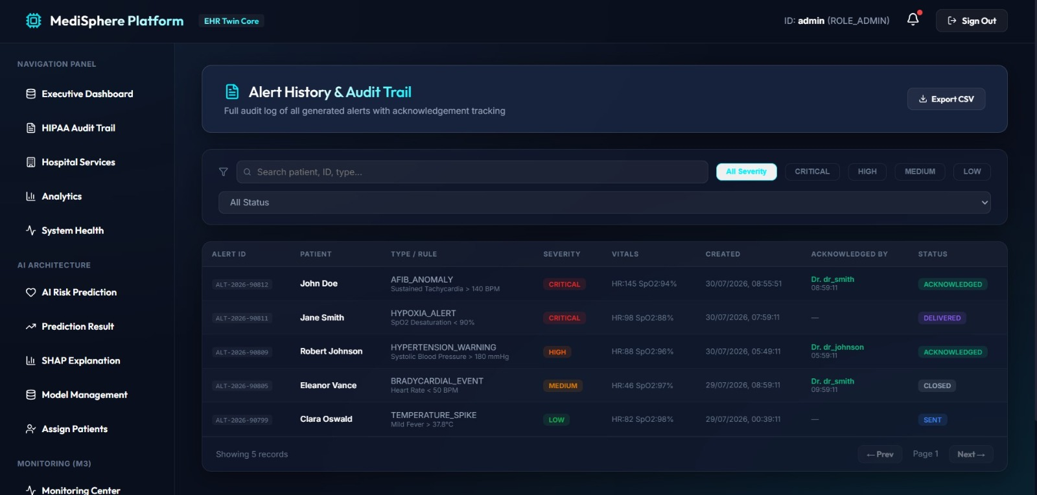

Slide 9
ROADMAP
Future Enhancements & Integration
Planned increments to extend MediSphere beyond its current scope.
1
2
3
Wearable Integration
Expanded Prediction Models
Telemedicine
Stream vitals directly from smartwatches & IoT health devices.
Extend beyond diabetes to cardiac risk and other chronic conditions.
In-app video consultations between doctors and patients.
4
5
6
Emergency SOS & Ambulance integration
Mobile App
AI Health Assistant
Automatic emergency alerts and ambulance dispatch for critical conditions
Native Android/iOS apps for patients and doctors on the go.
Chatbot for patient queries and appointment scheduling.
08

